Slide 1
KEY LOGGERS
CAPSTONE PROJECT
Presented By:
M.DHARSHINI-MOUNTZION COLLEGE OF ENGINEERING AND TECHNOLOGY-BE/CSE

Slide 2
OUTLINE
Problem Statement
Proposed System/Solution
System Development Approach
Algorithm & Deployment
Result Conclusion
Future Scope
References

Slide 3
Problem Statement
In today's digital age, where cybersecurity threats loom large, one of the significant concerns is the proliferation of keyloggers, stealthy software tools designed to monitor and record keystrokes on a user's computer without their knowledge. Keyloggers pose a severe threat to individuals and organizations as they can capture sensitive information such as passwords, credit card details, and other personal data, leading to identity theft, financial loss, and privacy breaches.

Slide 4
Proposed Solution
To address the problem of keyloggers, a Python-based keylogger detection system is proposed. This system utilizes the pynput library to monitor keyboard events and detect suspicious keystroke patterns indicative of keylogging activity. The system logs keystrokes in real-time and analyzes them to identify potential keylogger behavior.

Slide 5
System Approach
Keylogger Detection Mechanism: The system employs a listener function to monitor keyboard events using the pynput library.
Event Handling: When a key is pressed or released, the corresponding event handlers (on_press and on_release) are triggered to capture the keystrokes.
Data Logging: Captured keystrokes are logged in two formats - a text file (key_log.txt) and a JSON file (key_log.json), providing flexibility in data analysis and interpretation.
Real-time Analysis: Suspicious keystroke patterns are analyzed in real-time to detect potential keylogger activity.
User Interface: The system features a simple graphical user interface (GUI) using Tkinter for user interaction, including start and stop buttons for controlling the keylogger.

Slide 6
Algorithm & Deployment
Algorithm: The system algorithm involves event-driven programming, where keyboard events are captured and processed using event handlers (on_press and on_release).
Deployment: The system can be deployed on any system with Python installed, providing cross-platform compatibility. Users can run the application to initiate the keylogger detection process.

Slide 7
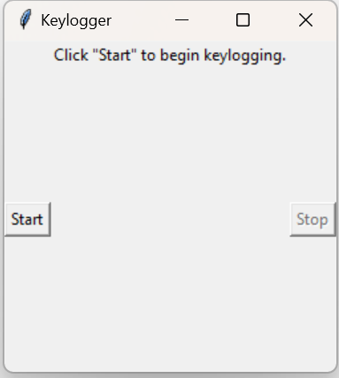
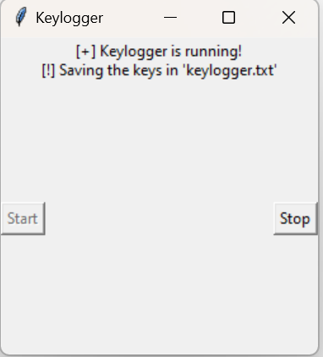
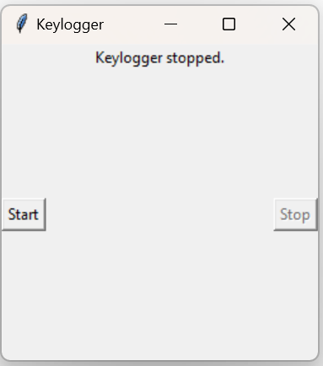
Result
Upon deployment, the keylogger detection system successfully monitors keyboard events and logs keystrokes in real-time.

Slide 8
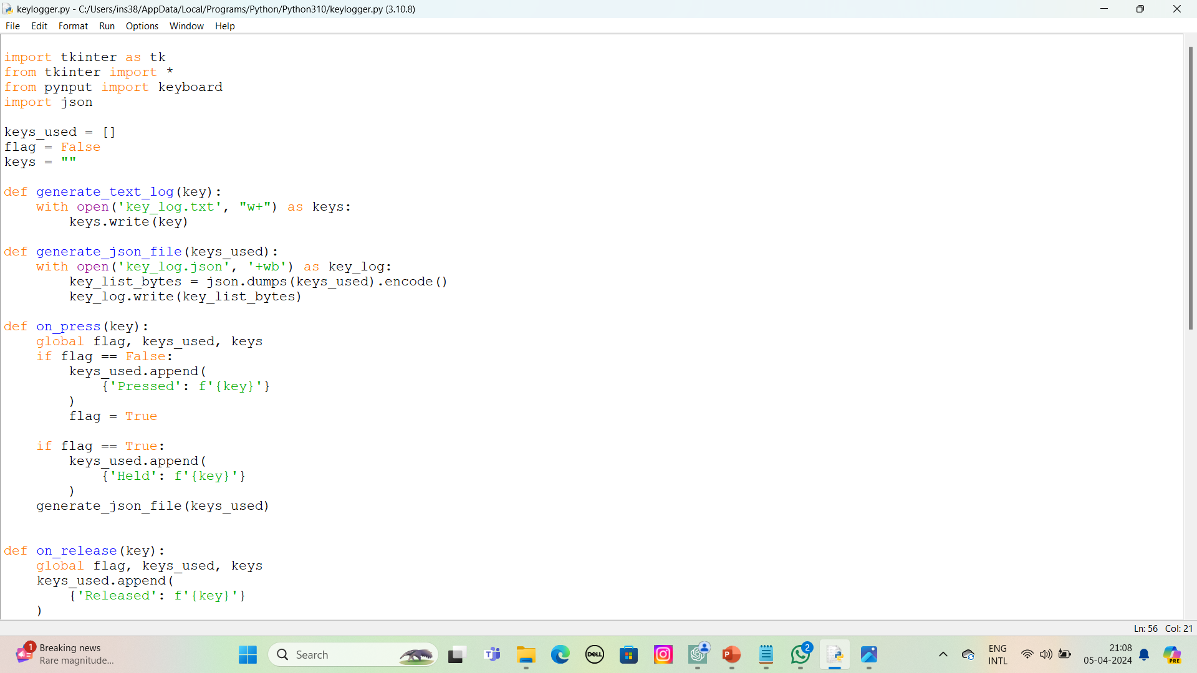
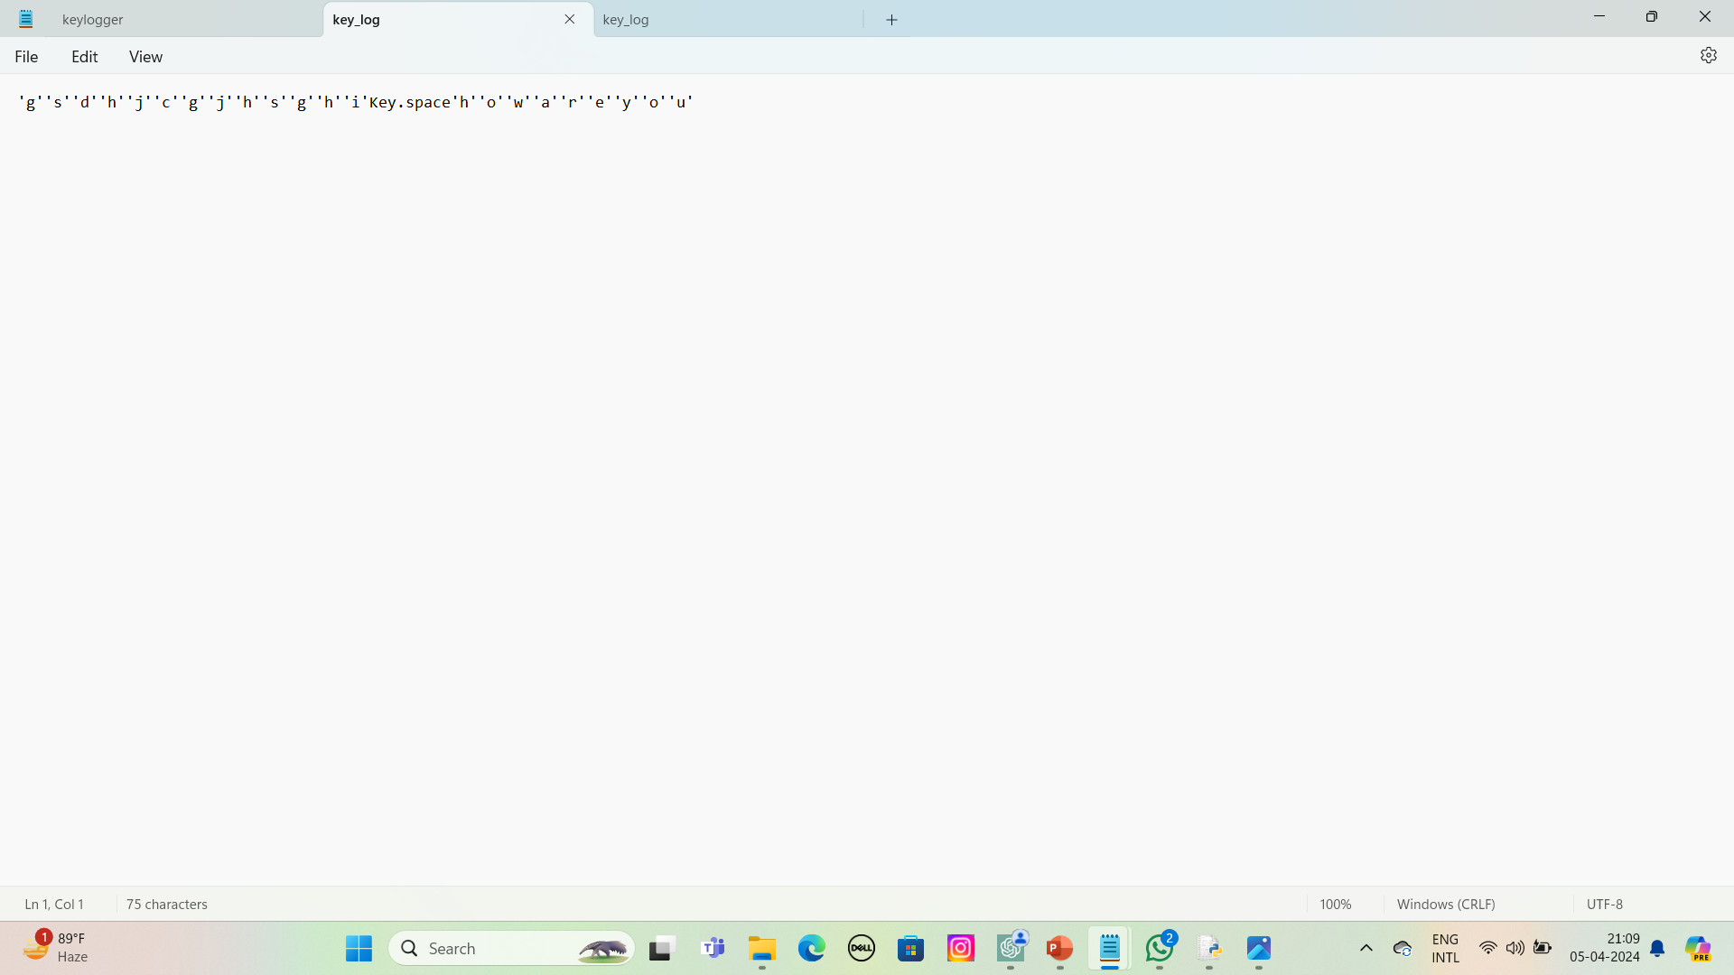
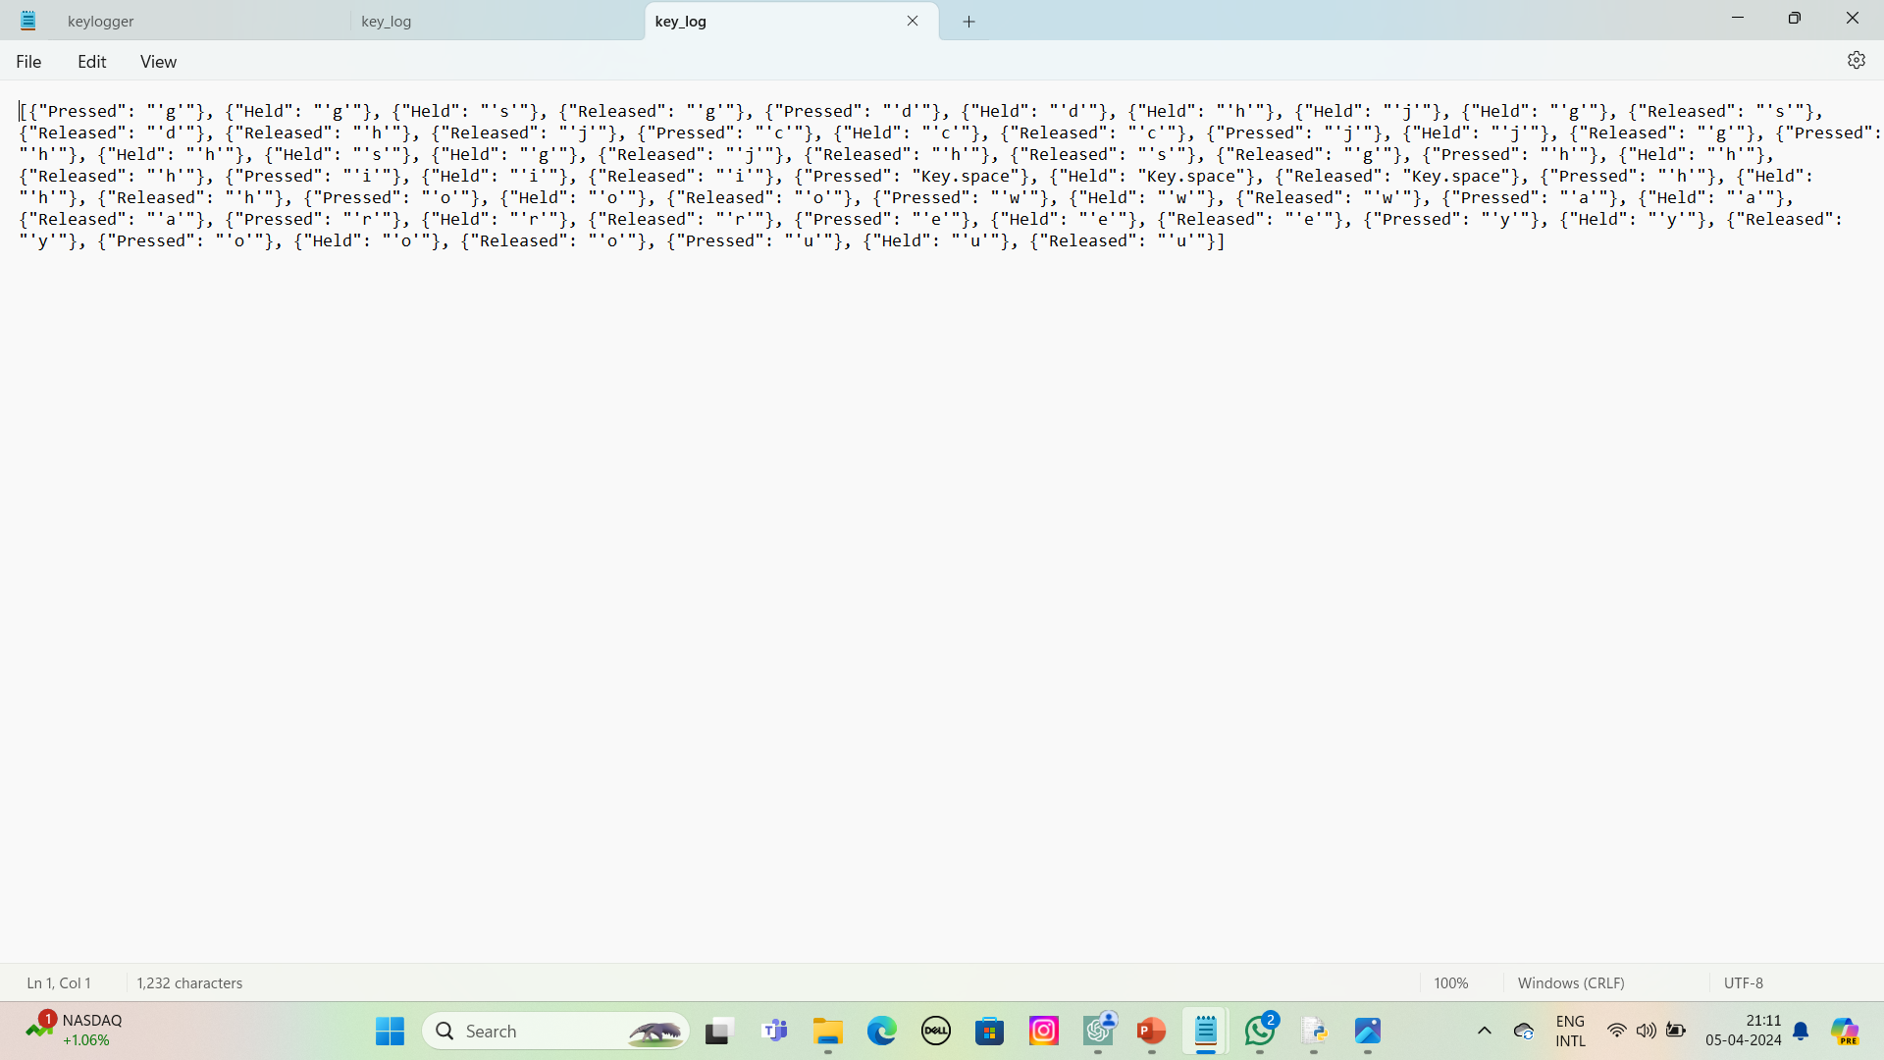
output

Slide 9
Conclusion
By analyzing captured data, potential keylogger activity can be identified and mitigated, enhancing cybersecurity measures. The system offers a practical solution for detecting and combating keyloggers, contributing to the protection of sensitive information.

Slide 10
Future scope
Enhanced Detection Techniques: Further research can focus on developing advanced detection algorithms to improve the accuracy and efficiency of keylogger detection.
User Notification: Implementing real-time alerts or notifications to users when suspicious activity is detected can enhance the system's usability and effectiveness.
Integration with Security Suites: Integration with existing security software suites can provide comprehensive protection against a wide range of cybersecurity threats.
Performance Optimization: Optimizing the system's performance to minimize resource usage and maximize efficiency, ensuring minimal impact on system performance.

Slide 11
References
Python Documentation: https://docs.python.org/3/
pynput Documentation: https://pynput.readthedocs.io/en/latest/
Tkinter Documentation: https://docs.python.org/3/library/tkinter.html
Cybersecurity Best Practices: https://www.cisa.gov/cybersecurity-best-practices
2 / 2
Python Documentation: https://docs.python.org/3/
pynput Documentation: https://pynput.readthedocs.io/en/latest/
Tkinter Documentation: https://docs.python.org/3/library/tkinter.html
Cybersecurity Best Practices: https://www.cisa.gov/cybersecurity-best-practices

Slide 12
THANK YOU

